Slide 1
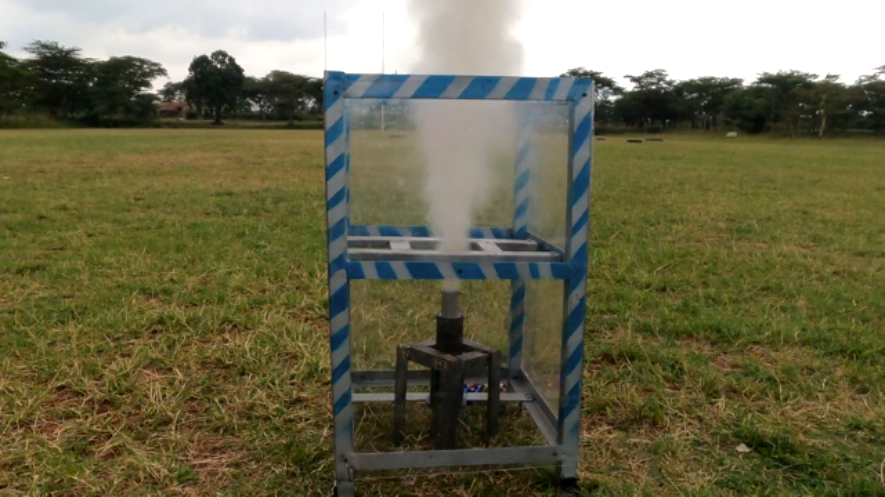
Batch 2 week 7 progress report

Slide 2
THIS WEEK’S OBJECTIVES
COOK 2 FULL GRAINS THROUGH MELTING AND RECASTING.
TEST THE REMOTE IGNITION SYSTEM
DESING THE COMPRESSION MECHANISM FOR CASTING
PERFORM FIRST STATIC TEST

Slide 3
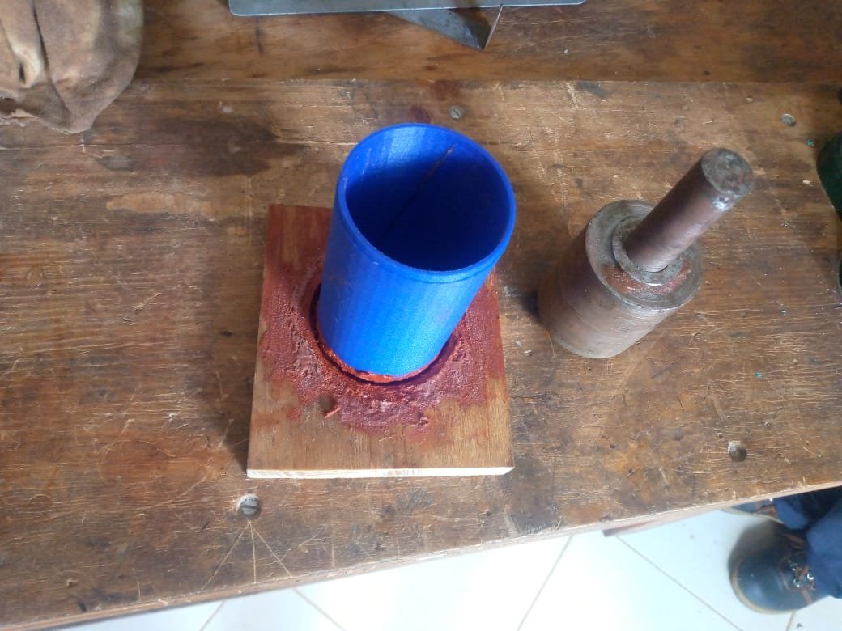
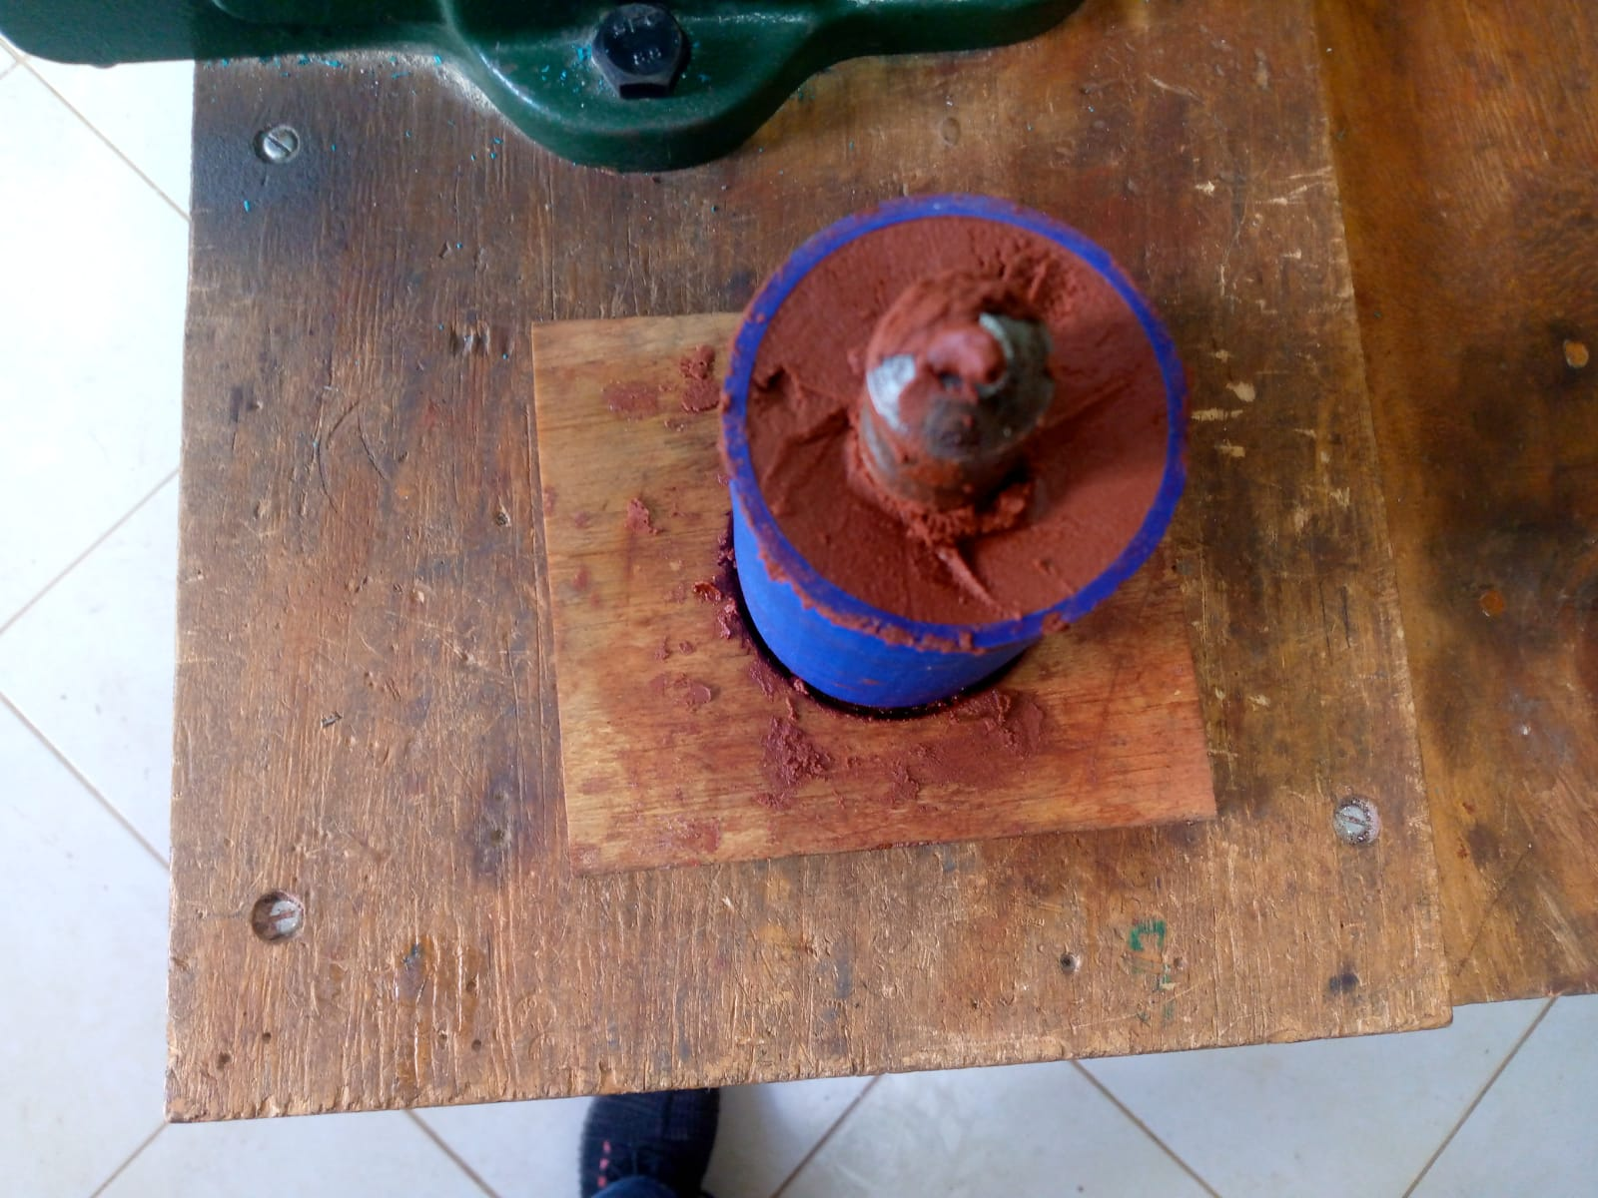
COOK 2 FULL GRAINS
Preparation of the grains

Slide 4
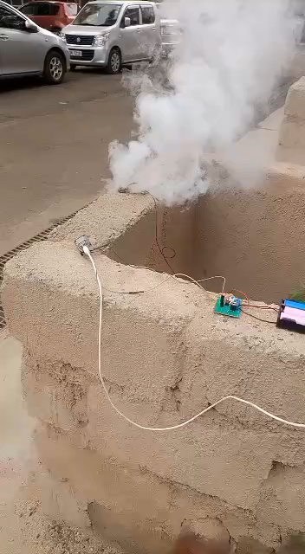
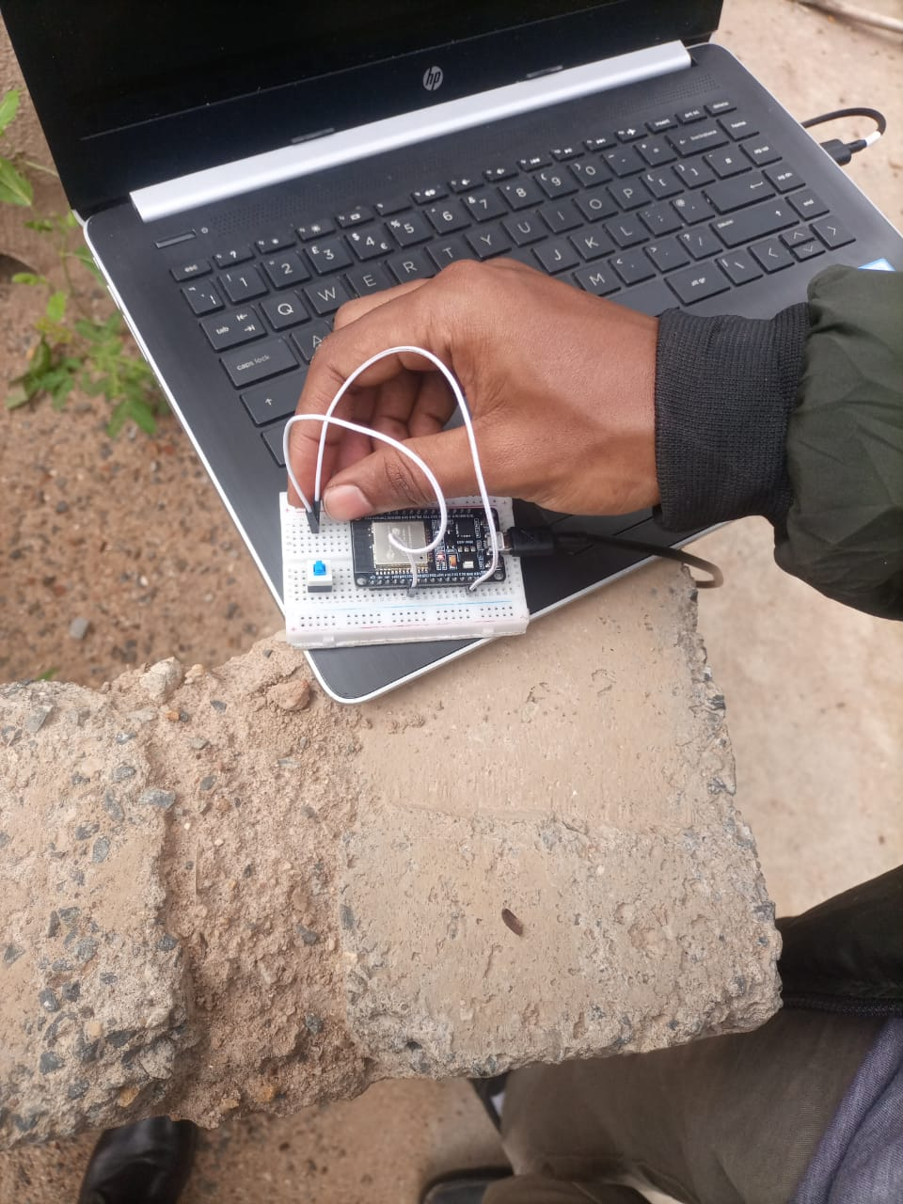
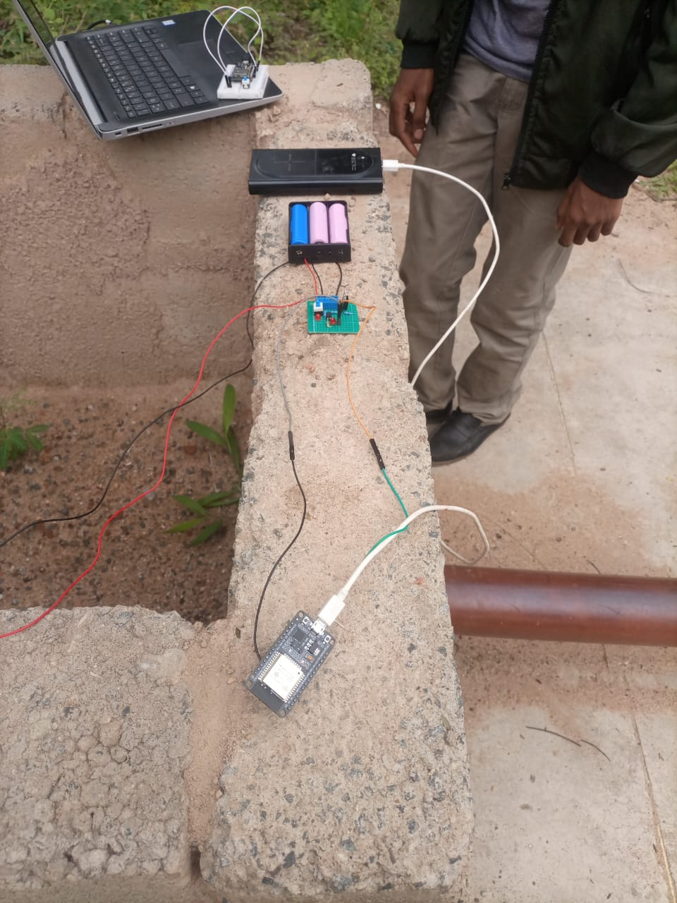
REMOTE IGNITION TEST

Slide 5
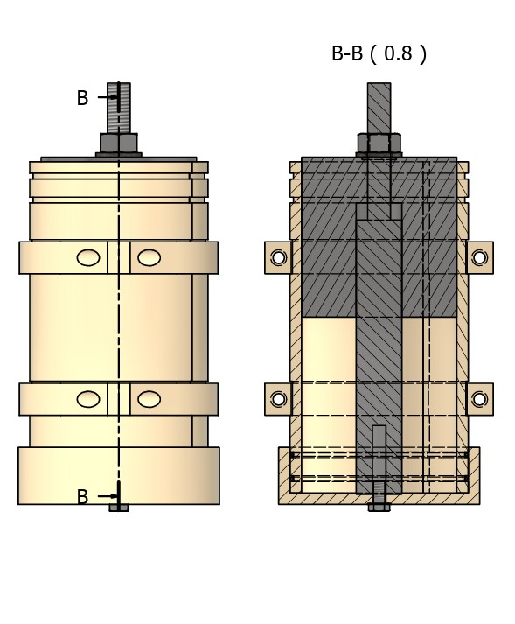
The new compression mechanism for the KNSB propellant:
To be 3D printed

Slide 6
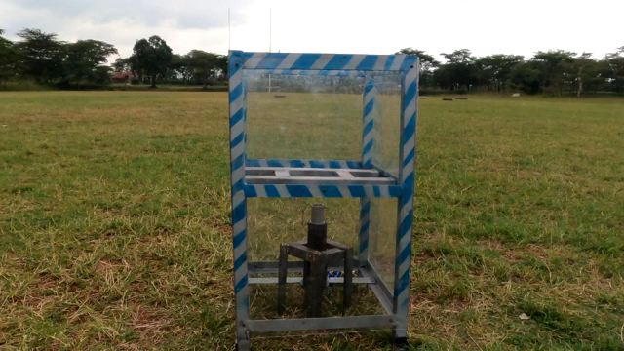
BUILD UP TO THE STATIC TEST
TAPPING THE MILD STEEL NOZZLE TO SATISFACTION
POLISHING THE MINIATURE CASING
PREPARING THE GRAIN
PREPARING THE IGNITION SYSTEM
SETTING UP THE TEST STAND
ASSEMBLING THE MOTOR

Slide 7
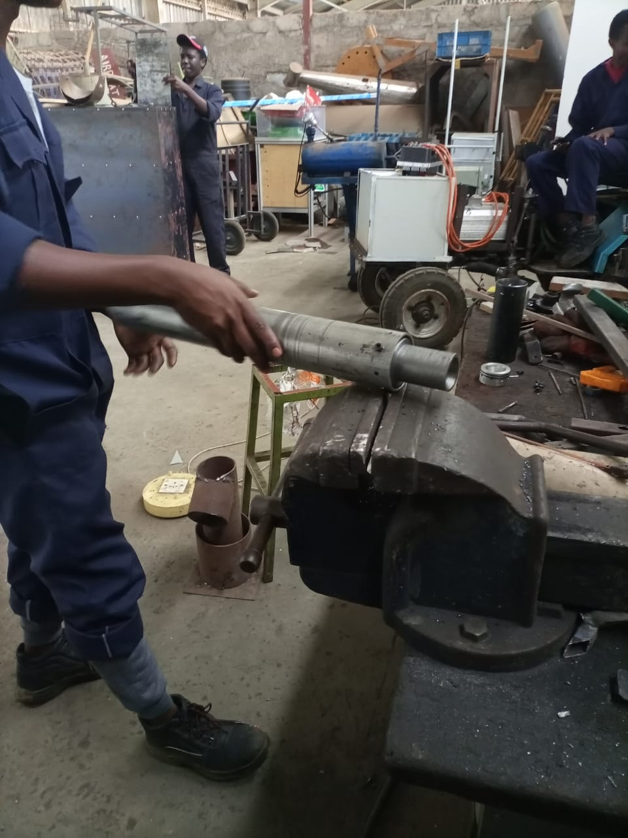
1. Tapping the mild steel nozzle
Modified our previous method of approach with mild steel

Slide 8
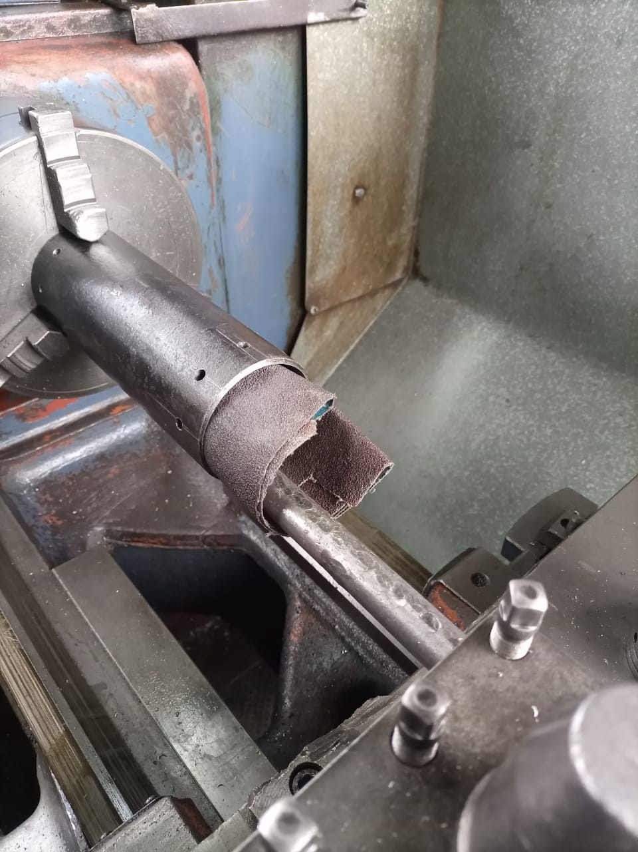
2. Sanding the miniature casing
Noted that polishing the casing eased the insertion of the bulkhead and the nozzle
O-ring tear due to unpolished walls

Slide 9
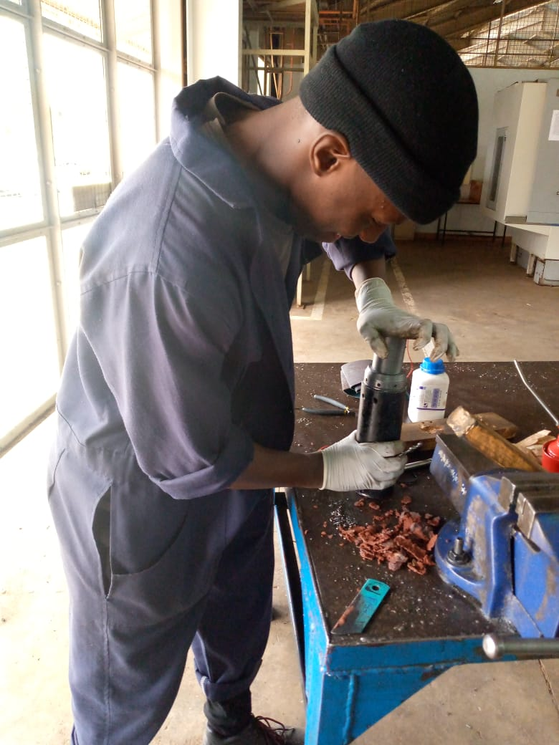
3. Preparation of the grain
Peeling of the excess material on its outside diameter
Excess propellant

Slide 10
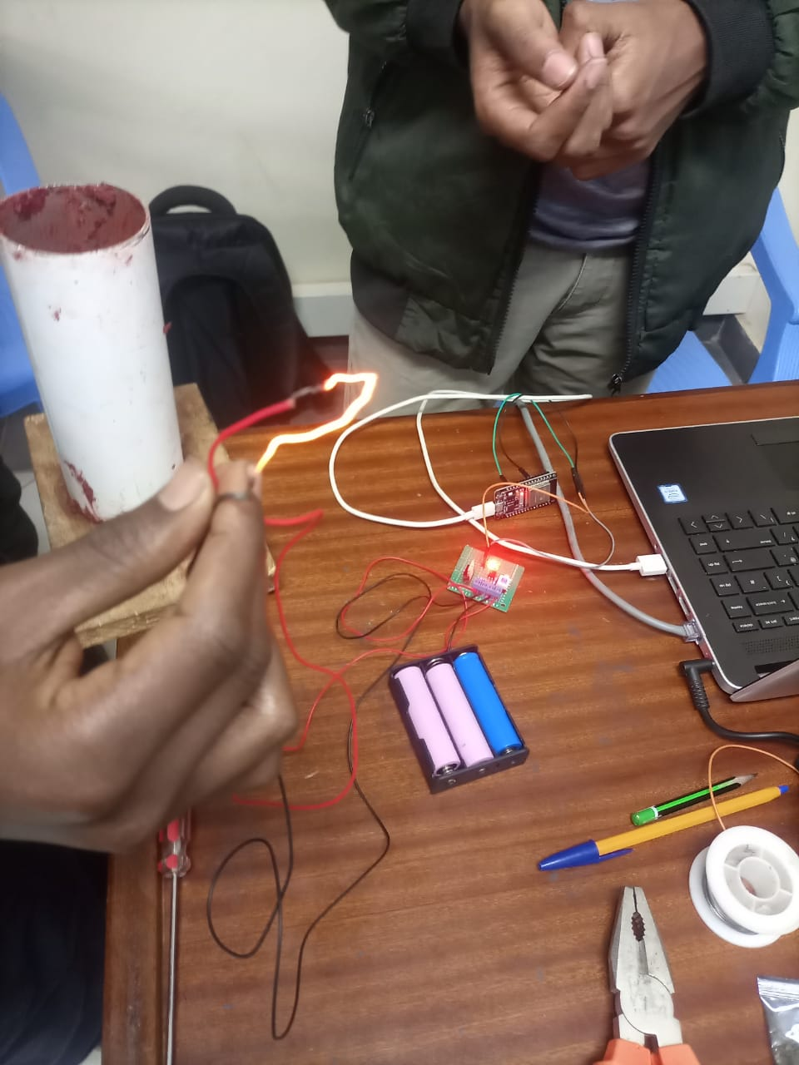
4. Preparation of the ignition system
Molded an igniter with the inclusion of ignition powder in conjunction with the KNSB propellant

Slide 11

5. Setting up the test stand
Modification with the inclusion of a steel block for stability
Noted the need of a sturdy platform to place the steel block
Steel block

Slide 12
6. Assemble the motor
Issue of O-ring tear

Slide 13
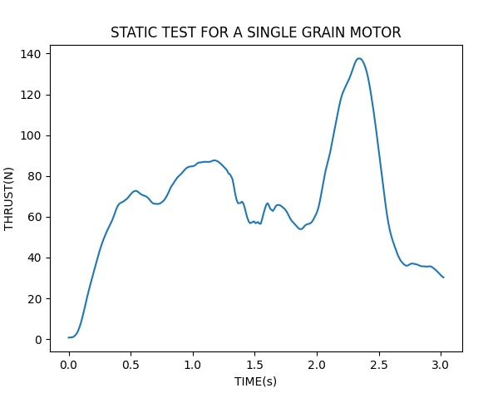
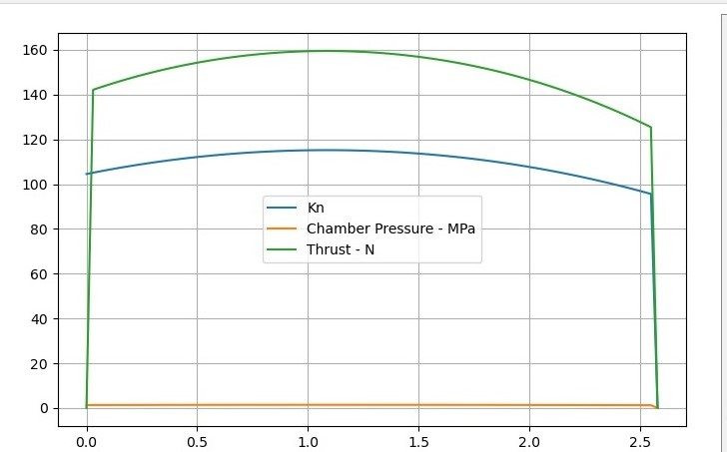
COMPARISON OF THRUST CURVES
SIMULATED GRAPH
GRAPH FROM OUR TEST
TIME(s)

Slide 14
ANALYSIS OF OUR RESULTS:
Peak thrust obtained is 138 N
The data transmitted is inconsistent
Burn-time is close to the theoretical value (2.58s)
Total impulse generated was 203.11Ns against the theoretical 383.55Ns
Specific impulse was 43.13s; expected 74.77s

Slide 15
The week’s challenges
Hole alignment
Couldn’t 3D print more casting equipment

Slide 16
NXEEK’S OBJECTIVES.
Next week’s objectives
1. MODIFY THE CASE FABRICATION PROCESS.
1
2. COOK 1 GRAIN FROM SCRATCH.
2
3. CREATE MORE CASTING TOOLS.
3
4. PREP THE TWO GRAIN MOTOR.
4

Slide 17
THANK YOU

